Slide 1
EXTENT OF DRUG USAGE
By
TERM PAPER TEAM
Lakshmi Sundararajan
Pallavi Attimakula
Natya Srinivasan
Guided by
Dr.Jongwook Woo

Slide 2
Table of contents
Project Scope
Specification of dataset
Hardware Specifications
Software’s used
Project Work Flow
Queries & Visualizations
Github link
References

Slide 3
Project Scope
The main motive of our project is to perform analysis that deals with the extent of drug usage amongst different age groups. This way we can know which age groups and under what conditions they are more addicted to drugs.
The predominant usage of various drugs are identified and this helps to analyze the average drug usage along the years and their addiction levels.
This also helps to identify the period of usage of drugs which further gives recommendations to overcome addiction.

Slide 4
Specification Of Dataset
Data set link:
http://www.icpsr.umich.edu/icpsrweb/ICPSR/studies/36361
Dataset size: 463Mb
Format: Comma Separated Value(CSV)
The data was obtained from the source which was collected by The Interuniversity Consortium for Political and Social Research (ICPSR) advances and expands social and behavioral research.
It also provides access to an extensive collection of data which paves the way to determine solutions to various issues and recommendations.
One amongst such datasets is regarding National Survey on Drug Use and Health 2014, which gained our attention.

Slide 5
Hardware Specifications
Data Nodes – 1 nodes | vCPU = 4( 24 GB RAM )
Management Nodes- 1 | vCPU = 12 ( 48 GB RAM )
Cluster Type – Hadoop IBM Big Insights
Version – IOP 4.2 [IBM Open Version Platform]
Operating System – CentOS 6.6 [Linux]
Data Disk- 1 TB SATA | Data Storage- 244 GB
CPU Processor 2.25GHz

Slide 6
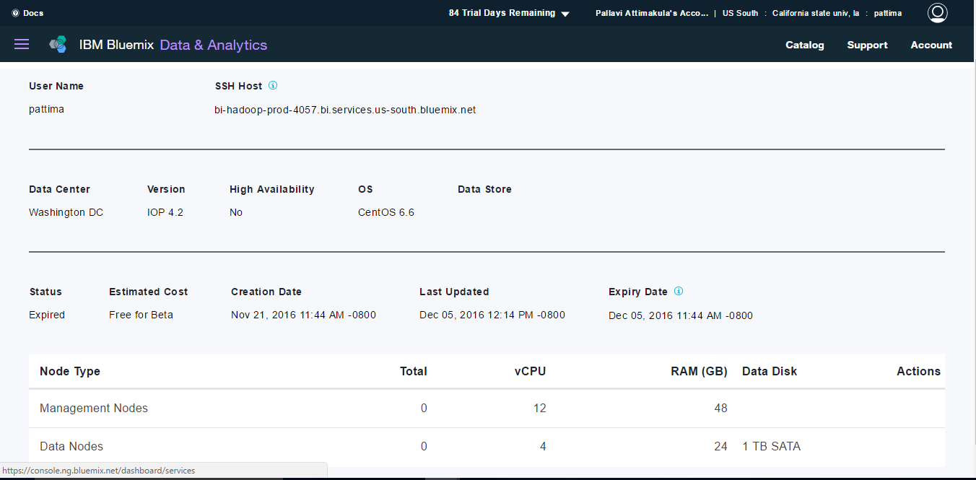
Hadoop BigInsights Cluster

Slide 7






Software's Used

Slide 8
Project Work Flow
Data Collection & Cleaning
Loading Data in local file system using WinSCP
Loading data into HDFS
Creating tables in Hive
Querying data in hive
Visualize Using POWER PIVOT and TABLEAU
Export Query results to MS EXCEL

Slide 9
Queries And Visualizations
CREATE TABLE Heroine_reasons
ROW FORMAT DELIMITED FIELDS TERMINATED BY '|'
STORED AS TEXTFILE LOCATION '/user/pattima/drug/result3'
AS
SELECT *,IF((hrdaypmo)<20,'Teenagers',IF((hrdaypmo)>20,'Adults','0')) As Age_of_ppl,
IF((HRDAYPWK=91),'not even a week','1 week') As No_of_days_per_week,
CASE
WHEN HERYRTOT=997 THEN 'refused'
WHEN HERYRTOT=991 THEN 'hate heroine'
ELSE 'Don’t Know'
END AS Reason
FROM heroine;

Slide 10
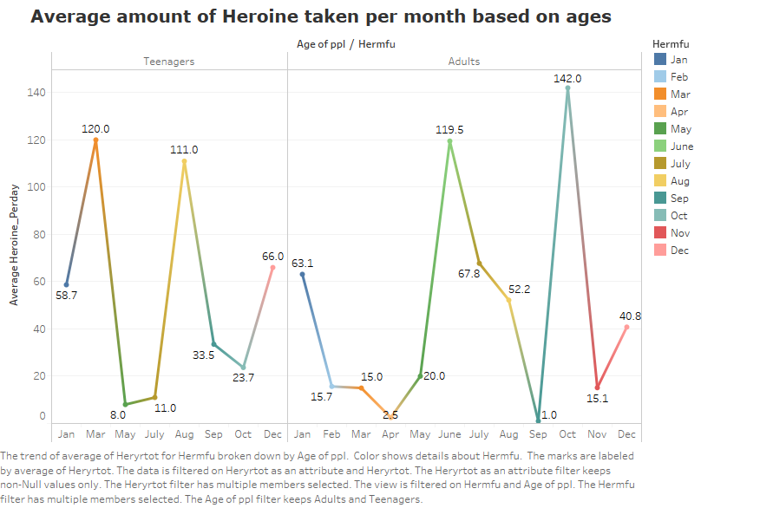
Different Age groups consuming Heroin
In the visualization, the average usage of heroine per month is taken for different age groups. This clearly states that the age group above 20 i.e., the adults are very much addicted to heroine when compared to teenagers and this sheet also depicts on which month the heroine usage is more.

Slide 11
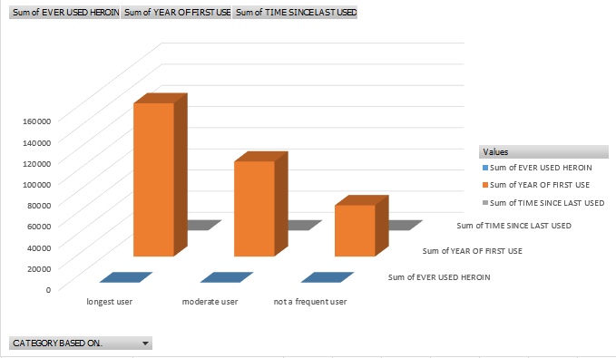
Usage Of Heroin
In this visualization the longest user, moderate user and not a frequent users are identified based on the duration of usage. The duration is derived from the first time a person used heroin to the time last used. Thus we can identify that there are more no. of users of heroin. The longest users are the people who have been consuming heroin continuously from 2012 to 2014 who appear to be huge in number.

Slide 12
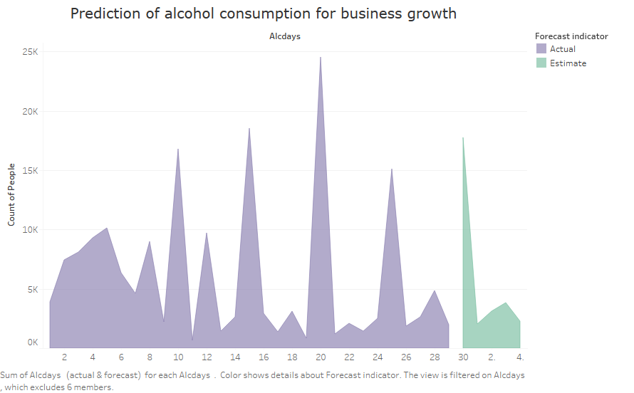
Expanse of Alcohol Consumption
The visualization holds the data of the people who consume alcohol everyday. With this data, we have forecasted the alcohol usage for the upcoming days. Interestingly it is found that this prediction not only tells us about the extent of alcohol consumption but also it can be used for the increase in sales by liquor companies.

Slide 13
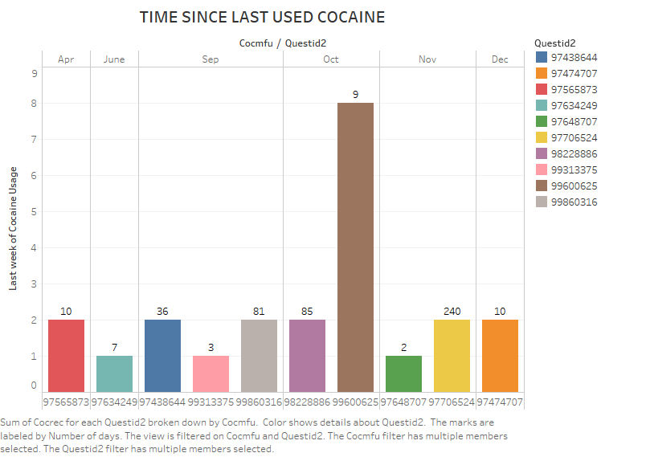
Time since last used cocaine
This visualization gives an analysis on how many days people have used cocaine and on which month and on which week they stopped using cocaine. The y-axis has the week details and the x-axis has the quest id of each person. This clearly shows that the usage of cocaine has been reduced mostly on second week of the month.

Slide 14
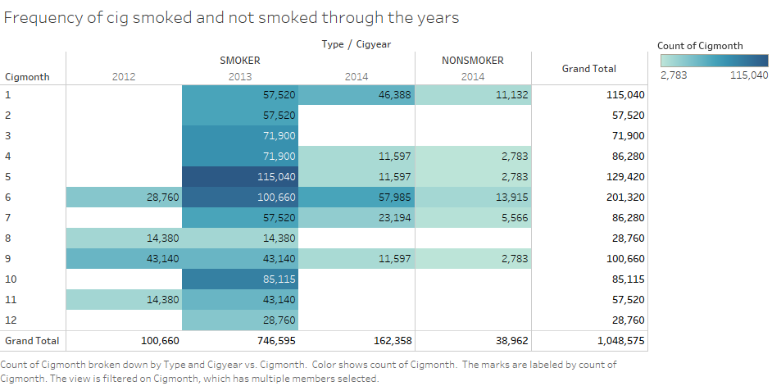
Statistics of smokers and non-smokers
From this visualization it is evident that the ratio of smokers and non-smokers has been unstable over the years.In the year 2012 there were 1,00,660 smokers , later in 2013 there was a drastic increase of smokers to 7,46,595.Interestingly, the count of smokers dropped to 1,62,358 as it seems that more people may have decided not to smoke.

Slide 15
Table Creation Samples
DROP TABLE IF EXISTS CIGESTIMATE;
CREATE EXTERNAL TABLE IF NOT EXISTS Cigestimate
(CASEID BIGINT,QUESTID BIGINT,CIGEVER INT,CIGWILYR INT,CIGREC INT,
CIG30AV INT,CG30EST INT)
ROW FORMAT DELIMITED FIELDS TERMINATED BY '|'
STORED AS TEXTFILE LOCATION '/user/pattima/drug/cig'
TBLPROPERTIES ('skip.header.line.count'='1');

Slide 16
Age wise Statistics
CREATE TABLE IF NOT EXISTS smoke_stat
ROW FORMAT DELIMITED FIELDS TERMINATED BY '|'
STORED AS TEXTFILE LOCATION '/user/pattima/drug/smoke_stat'
AS
select CIGFREQUENCY.CASEID,CIGFREQUENCY.CIGAGE,FIRSTCIGSMOKE.CIGTRY,
Case
when CIGFREQUENCY.CIGAGE=FIRSTCIGSMOKE.CIGTRY OR CIGFREQUENCY.CIGAGE<FIRSTCIGSMOKE.CIGTRY then'HIGHRISK'
else 'LOWRISK'
end
from CIGFREQUENCY, FIRSTCIGSMOKE
where CIGFREQUENCY.CASEID=FIRSTCIGSMOKE.CASEID ;

Slide 17
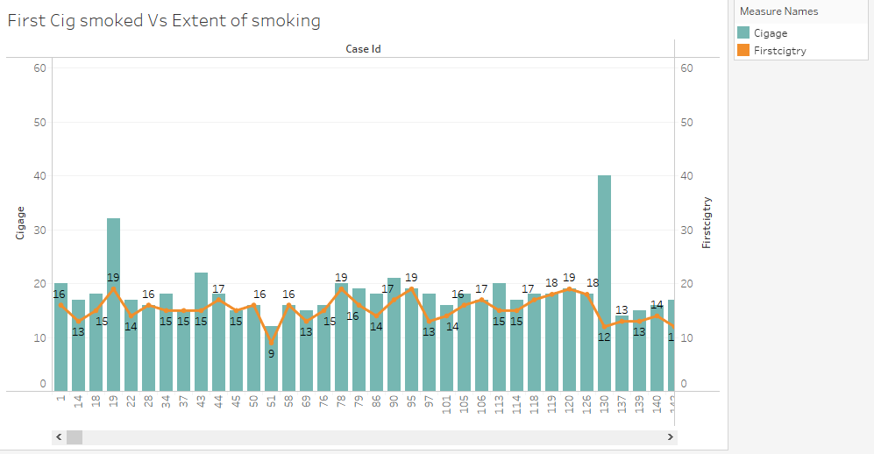
Extent of Smoking
In this chart we have analyzed the extent of cigarette smoking with respect to age group. This analysis gives us an insight on the time span of people getting addicted to smoking.
The time span can be calculated by checking the difference of age shown in the two graphs i.e line and chart depicted in this visualization.
For ex: Case id: 1 has
Cigage:20
FirstCigtry:16 having a time span of 4 years.

Slide 18
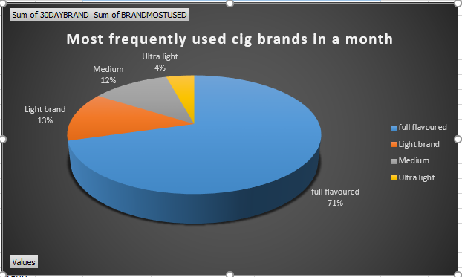
Cigarette brand analysis based on tobacco content
The cigarette brands are classified into full flavored, light brand , medium, ultra light as shown in the chart. These brands are being categorized based on the tobacco content in them . Amongst which, the full flavored brand which consists of high tobacco content was consumed the most i.e. 71%. So it is recommended to consume lesser amount of full flavored brand as it is more harmful.

Slide 19
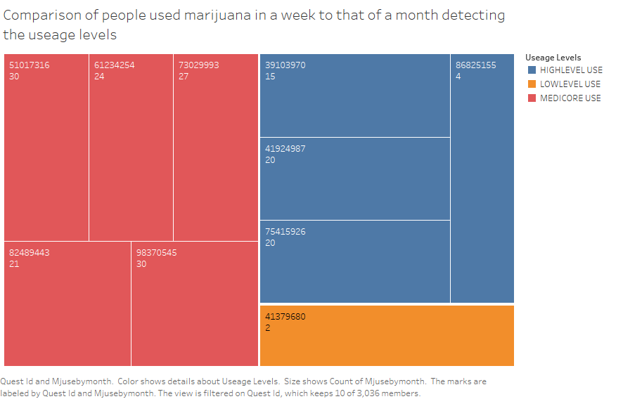
Marijuana Usage levels
This chart helps to categorize the various usage levels of marijuana with respect to months and weeks into high level, low level and mediocre levels. We can understand that there are more people who are considered as mediocre level users based on the average usage levels over the months and weeks.

Slide 20
Summary
With the drugs that we have used for analysis we can see that the usage of the major drugs is more common amongst the age group less than 20.
As a recommendation for social awareness we need to limit the availability of drugs to the age groups less than 20.
Our analysis can be helpful for the rehabilitation center for better treatment of drug addicts based on the usage levels and time span of addition as depicted in these visualization

Slide 21
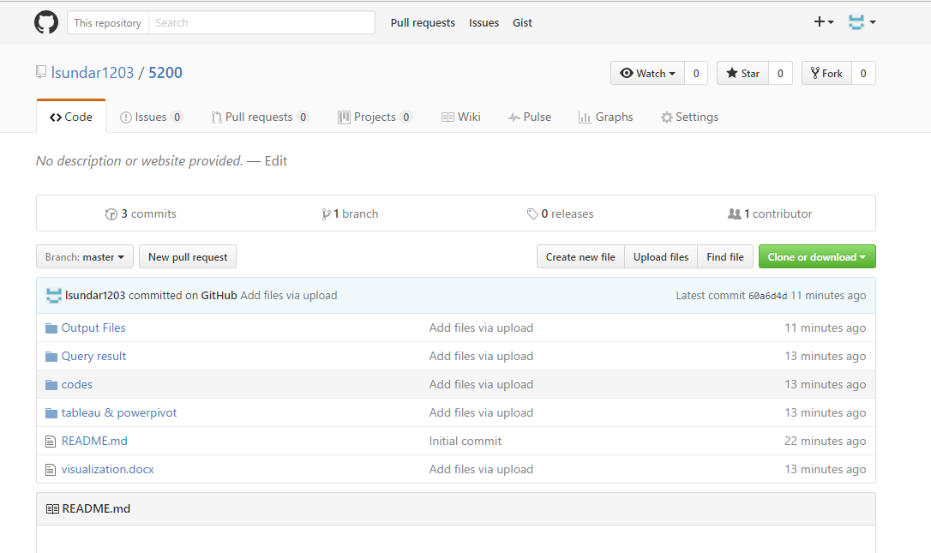
Github Link
https://github.com/lsundar1203/5200/upload/master

Slide 22
References
http://www.icpsr.umich.edu/icpsrweb/ICPSR/studies/36361
http://www.icpsr.umich.edu/icpsrweb/NAHDAP/
https://console.ng.bluemix.net/catalog/services/biginsights-for-apache-hadoop
https://winscp.net/eng/download.php

Slide 23
THANK YOU
Q&A

